Slide 1
Chapter 2
Looking at Data—Relationships
Lecture Slides
Introduction to the Practice of Statistics
Tenth Edition
David S. Moore George P. McCabe
Bruce Craig

Slide 2
Chapter 2
Looking at Data — Relationships
2.1 Relationships
2.2 Scatterplots
2.3 Correlation
2.4 Least-Squares Regression
2.5 Cautions about Correlation and Regression
2.6 Data Analysis for Two-Way Tables
2.7 The Question of Causation

Slide 3
2.1 Relationships
Association between variables
Explanatory and response variables
Key characteristics of a data set

Slide 4
Associations between Variables
Many interesting examples of the use of statistics involve relationships between pairs of variables.
Two variables measured on the same cases are associated if knowing the value of one of the variables tells you something that you would not otherwise know about the value of the other variable.
When you examine the relationship between two variables, a new question becomes important: Is your purpose simply to explore the nature of the relationship, or do you wish to show that one of the variables can explain variation in the other?
A response variable measures an outcome of a study. An explanatory variable explains or causes changes in the response variable.

Slide 5
Key Characteristics of a Data Set
Certain characteristics of a data set are key to exploring the relationship between two variables. These should include the following:
Cases: Identify the cases and how many there are in the data set.
Categorical or quantitative: Classify each variable as categorical or quantitative.
Values: Identify the possible values for each variable.
Explanatory or response: If appropriate, classify each variable as explanatory or response.
Label: Identify what is used as a label variable if one is present.

Slide 6
2.2 Scatterplots
Scatterplots
Interpreting scatterplots
Log transformation
Categorical variables in scatterplots

Slide 7
Scatterplot 1
The most useful graph for displaying the relationship between two quantitative variables is a scatterplot.
A scatterplot shows the relationship between two quantitative variables measured on the same cases.
The values of one variable appear on the horizontal axis, and the values of the other variable appear on the vertical axis.
Each case corresponds to one point on the graph.
How to Make a Scatterplot
Decide which variable should go on each axis. If a distinction exists, plot the explanatory variable on the x axis and the response variable on the y axis.
Label and scale the axes appropriately.
Plot individual data values.

Slide 8
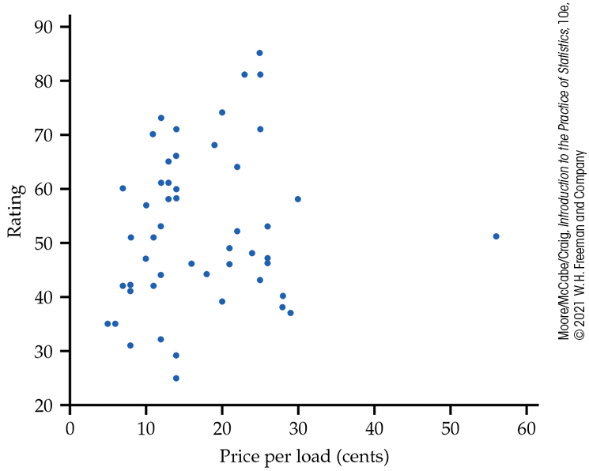
Scatterplot 2
  Example: Make a scatterplot of the relationship between price and rating for laundry detergents.
Price per load (cents) | 14 | 14 | 14 | 12 | 10 | 8 | … | 12
Rating | 60 | 58 | 60 | 53 | 57 | 41 | … | 32

Slide 9
Interpreting Scatterplots 1
  To interpret a scatterplot, follow the basic strategy of data analysis from Chapter 1. Look for patterns and important departures from those patterns.
How to Examine a Scatterplot
As in any graph of data, look for the overall pattern and for striking deviations from that pattern.
You can describe the overall pattern of a scatterplot by the form, direction, and strength of the relationship.
An important kind of departure is an outlier, an individual value that falls outside the overall pattern of the relationship.

Slide 10
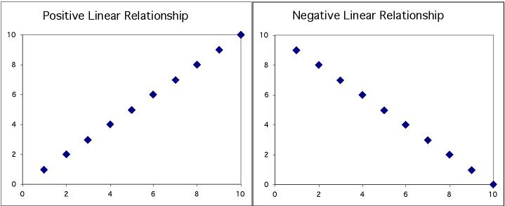
Interpreting Scatterplots 2
Two variables are positively associated when above-average values of one tend to accompany above-average values of the other and when below-average values also tend to occur together.
Two variables are negatively associated when above-average values of one tend to accompany below-average values of the other, and vice versa.

Slide 11
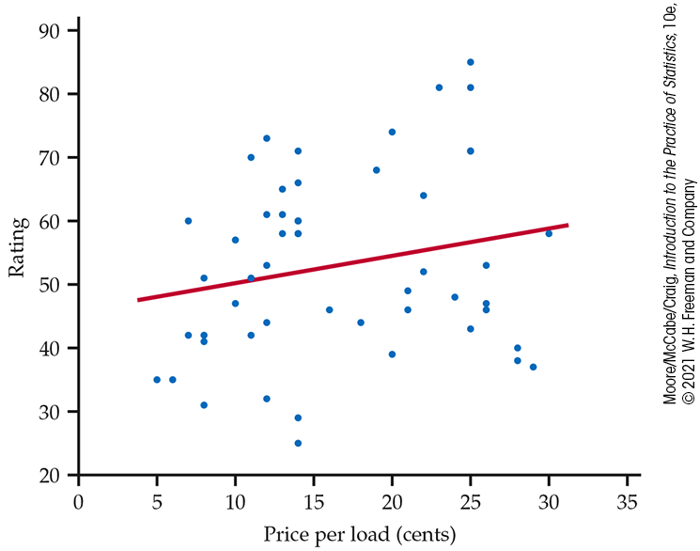
Interpreting Scatterplots 3
Outlier
There is one possible outlier: The detergent with the price per load of 56 cents seems to have a lower rating than one might expect if higher price means a higher-rated detergent.
Strength
Direction
Form
There is a moderately weak, positive, linear relationship between price per load and detergent rating.
It appears that more expensive detergents are rated slightly higher, with possibly one exception.

Slide 12
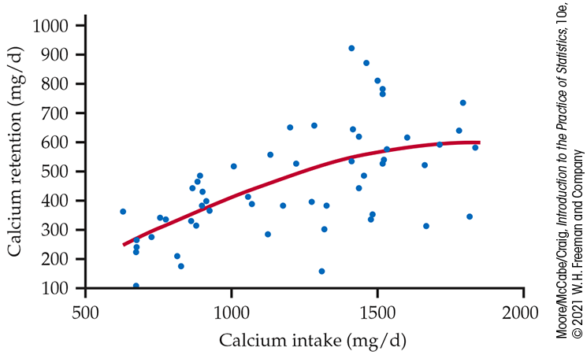
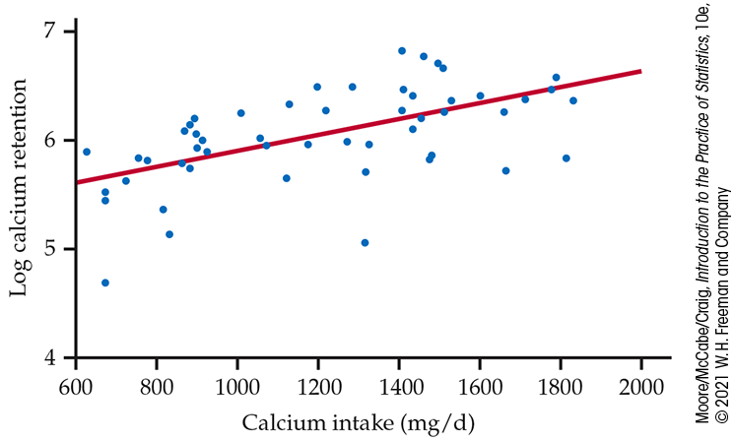
The Log Transformation
  Sometimes, the pattern that best describes data in a scatterplot is a curve other than a line. In this case, it is often useful to apply a transformation to the data that renders the relationship approximately linear.
The log transformation is the most important one used in this course.
It can be used only for variables whose values are positive.
The natural logarithm is what we use to perform this transformation.
  Example: Consider the following two scatterplots concerning calcium intake versus calcium retention.
  Original Scatterplot
  Log Transformation Scatterplot

Slide 13
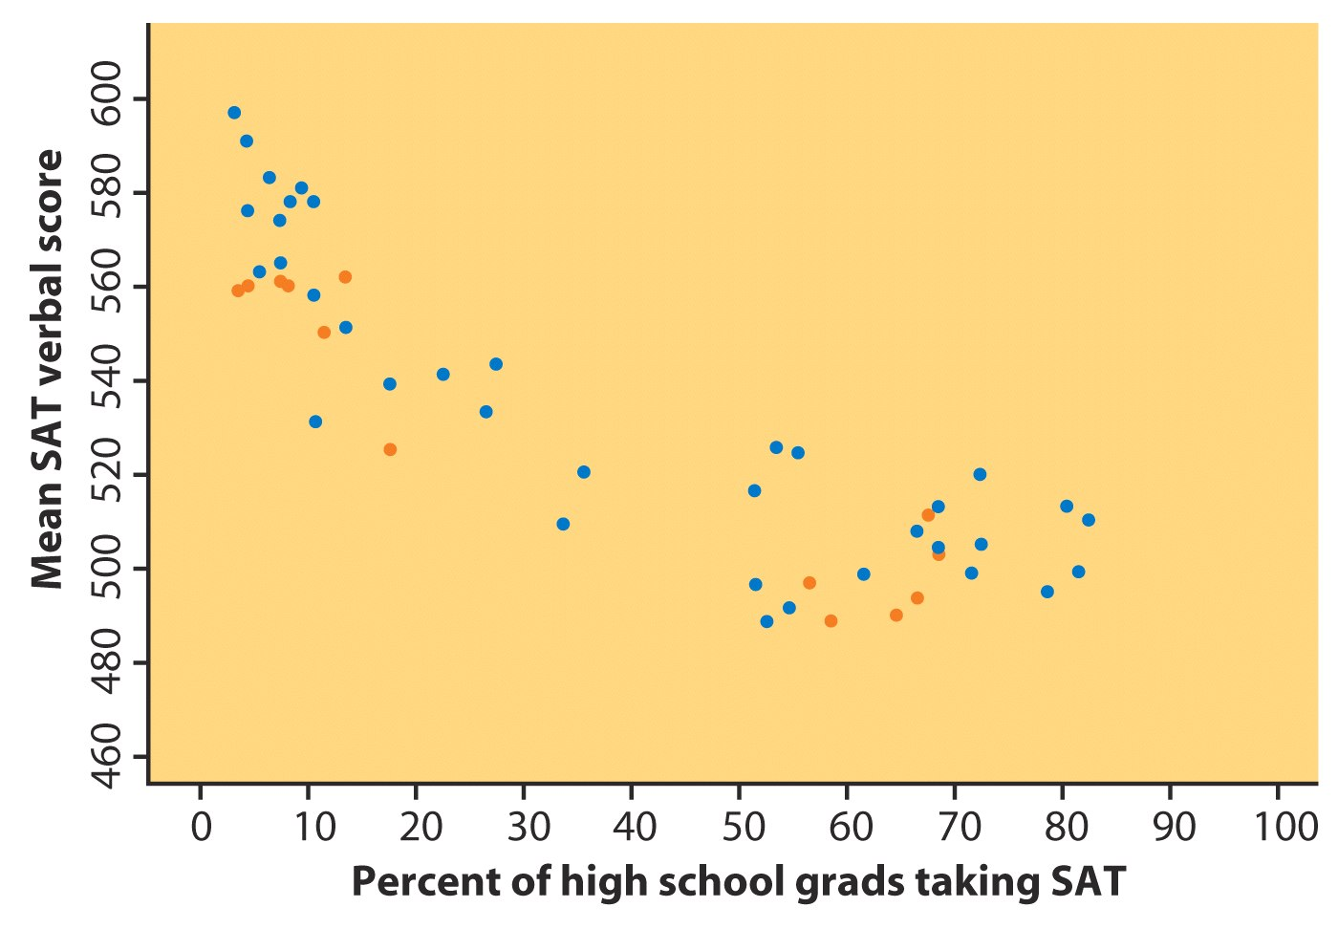
Adding Categorical Variables to a Scatterplot
Consider the relationship between mean SAT verbal score and percent of high school grads taking the SAT for each state.
To add a categorical variable, use a different plot color or symbol for each category.
Southern states are orange dots

Slide 14
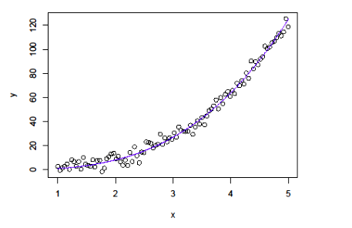
Nonlinear Relationships
There are other forms of relationships besides linear. The scatterplot below is an example of a nonlinear form.
Note the curvature in the relationship between x and y.

Slide 15
2.3 Correlation
The correlation r
Properties of correlation

Slide 16
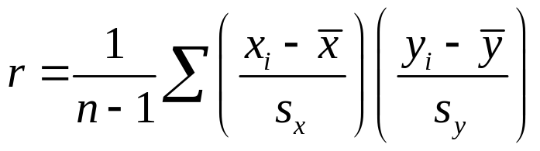
Measuring Linear Association 1
A scatterplot displays the strength, direction, and form of the relationship between two quantitative variables. Linear relationships are important because a straight line is a simple pattern that is quite common.
Our eyes are not always good judges of how strong a relationship is. Therefore, we use a numerical measure to supplement our scatterplot and help us interpret the strength of the linear relationship.
The correlation r measures the strength of the linear relationship between two quantitative variables. Using the notation explained on pp. 92 in the text:

Slide 17
Measuring Linear Association 2
A linear relationship is strong if the points lie close to a straight line and weak if they are widely scattered about a line.
The following facts about r help us further interpret the strength of the linear relationship.
Properties of Correlation
  r is always a number between –1 and 1, inclusive.
  r > 0 indicates a positive association.
  r < 0 indicates a negative association.
  Values of r near 0 indicate a very weak linear relationship.
  The strength of the linear relationship increases as r moves away from 0 toward –1 or 1.
  The extreme values r = –1 and r = 1 occur only in the case of a perfect linear relationship.

Slide 18
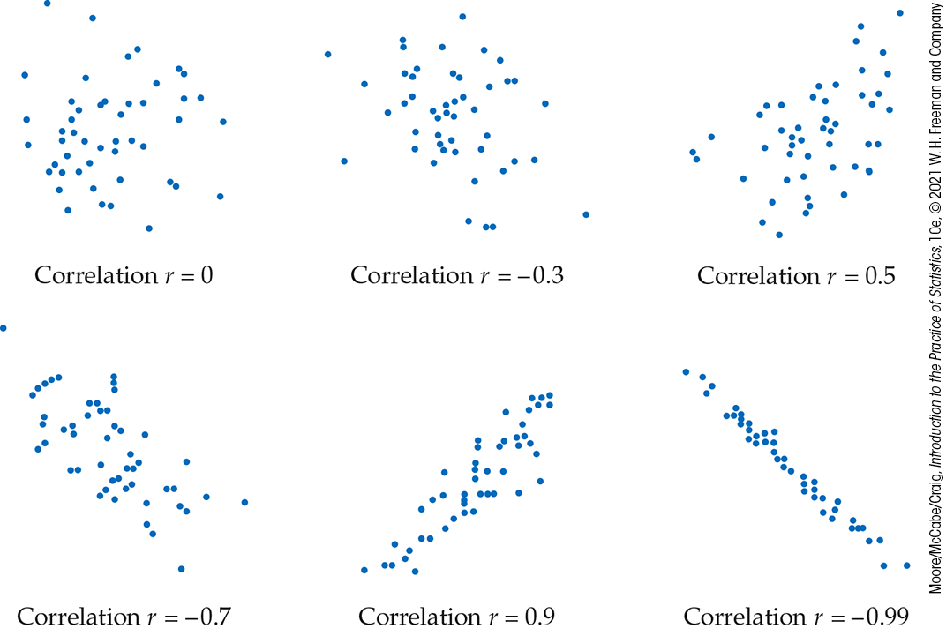
Correlation

Slide 19
Properties of Correlation
Correlation makes no distinction between explanatory and response variables.
r has no units and does not change when we change the units of measurement of x, y, or both.
Positive r indicates a positive association between the variables, and negative r indicates a negative association.
The correlation r is always a number between –1 and 1.
Cautions:
Correlation requires that both variables be quantitative.
Correlation does not describe curved relationships between variables, no matter how strong the relationship is.
The correlation r is not resistant; it can be strongly affected by a few outlying observations.
Correlation is not a complete summary of two-variable data.

Slide 20
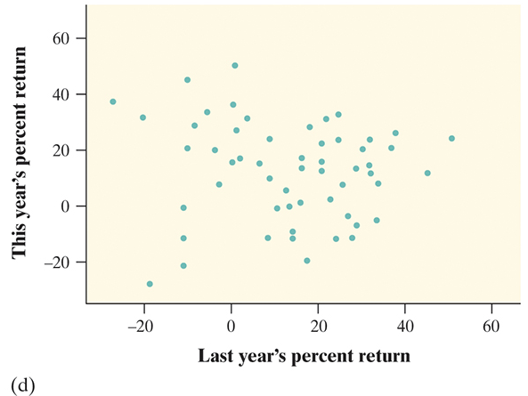
Correlation Examples
For each graph, estimate the correlation r and interpret it in context.

Slide 21
2.4 Least-Squares Regression
Regression lines
Least-squares regression line
Predictions
Facts about least-squares regression
Correlation and regression

Slide 22
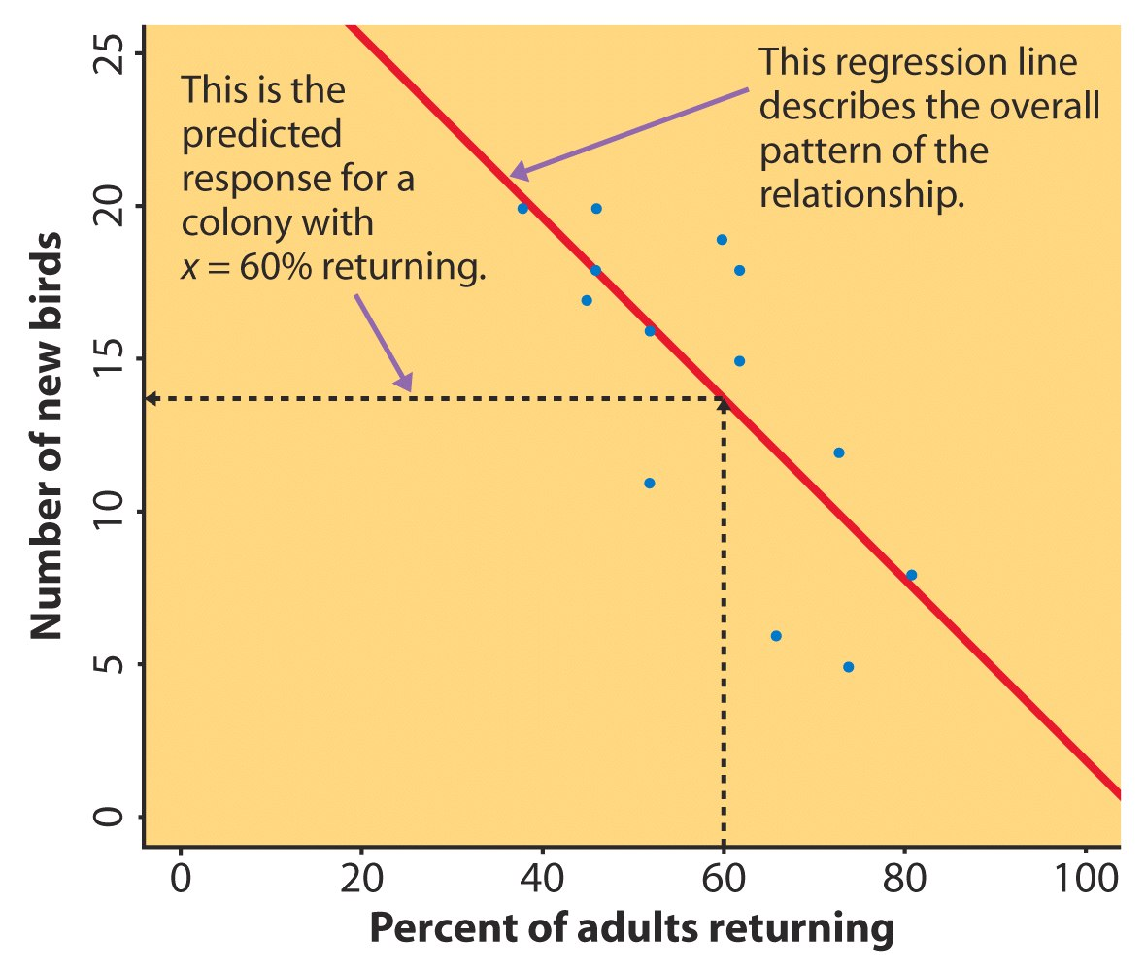
Regression Line 1
A regression line is a straight line that describes how a response variable y changes as an explanatory variable x changes.
We can use a regression line to predict the value of y for a given value of x.
Example: Predict the number of new adult birds that join the colony based on the percent of adult birds that return to the colony from the previous year.
If 60% of adults return, how many new birds are predicted?

Slide 23
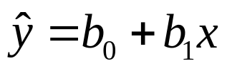
Regression Line 2
When a scatterplot displays a linear pattern, we can describe the overall pattern by drawing a straight line through the points.
Fitting a line to data means drawing a line that comes as close as possible to the points.
Regression equation:
  x is the value of the explanatory variable.
  “y-hat” is the predicted value of the response variable for a given value of x.
  b₁ is the slope, the amount by which y changes for each one-unit increase in x.
  b₀ is the intercept, the value of y when x = 0.

Slide 24
Least-Squares Regression Line
Because we are trying to predict y, we want the regression line to be as close as possible to the data points in the vertical (y) direction.
Least-Squares Regression Line (LSRL):
The least-squares regression line of y on x is the line that minimizes the sum of the squares of the vertical distances of the data points from the line.
If we have data on an explanatory variable x and a response variable y, the equation of the LSRL is
  y = b₀ + b₁x

Slide 25
Predictions Via Regression Line
Look back at the “returning birds” example. Here,
the LSRL is y-hat = 31.9343 − 0.3040
y-hat is the predicted number of new birds for colonies with x percent of adults returning.
Suppose we know that an individual colony has 60% returning.
What would we predict the number of new birds to be for just that colony?
For colonies with 60% returning, we predict the average number of new birds to be
31.9343 − (0.3040)(60) = 13.69 birds

Slide 26
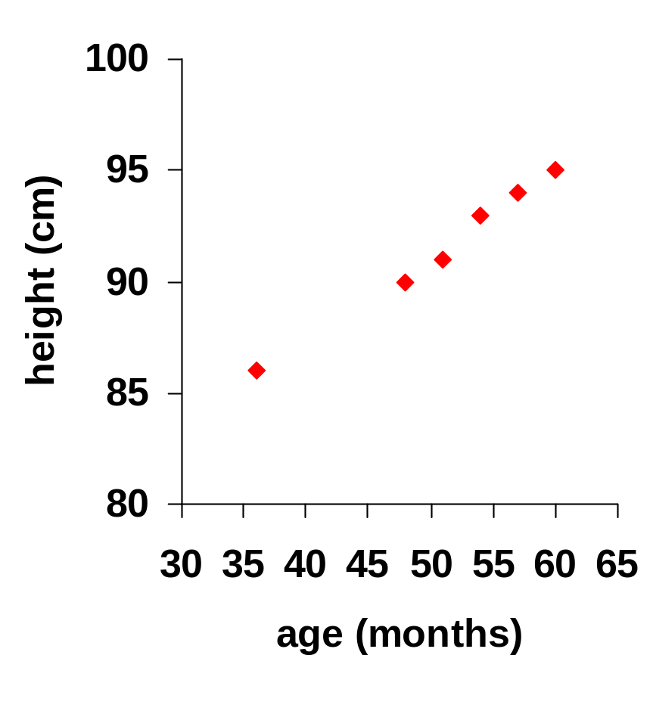
Extrapolation 1
Sarah’s height was plotted against her age.
Can you guess (predict) her height at age 42 months?
Can you predict her height at age 30 years (360 months)?

Slide 27
Extrapolation 2
Regression line:
y-hat = 71.95 + 0.383 x
Height at age 42 months? y-hat = 88
Height at age 30 years? y-hat = 209.8
  She is predicted to be 6’10.5” at age 30! What’s wrong with this?

Slide 28
Facts about Least-Squares Regression
Regression is one of the most common statistical settings, and least- squares is the most common method for fitting a regression line to data.
Here are some facts about least-squares regression lines.
Fact 1: A change of one standard deviation in x corresponds to a change of r standard deviations in y.
Fact 2: The LSRL always passes through (x-bar, y-bar)
Fact 3: The distinction between explanatory and response variables is essential.

Slide 29
Correlation and Regression
Least-squares regression looks at the distances of the data points from the line only in the y direction. As a result, the variables x and y play different roles in regression.
Even though correlation r ignores the distinction between x and y, there is a close connection between correlation and regression.
The square of the correlation, r², is the fraction of the variation in values of y that is explained by the least-squares regression of y on x.
  r² is sometimes called the coefficient of determination.

Slide 30
2.5 Cautions about Correlation and Regression
Residuals and residual plots
Outliers and influential observations
Lurking variables
Correlation and causation

Slide 31
Residuals
A regression line describes the overall pattern of a linear relationship between an explanatory variable and a response variable.
Deviations from the overall pattern are also important. The vertical distances between the points and the least-squares regression line are called residuals.
A residual is the difference between an observed value of the response variable and the value predicted by the regression line:

Slide 32
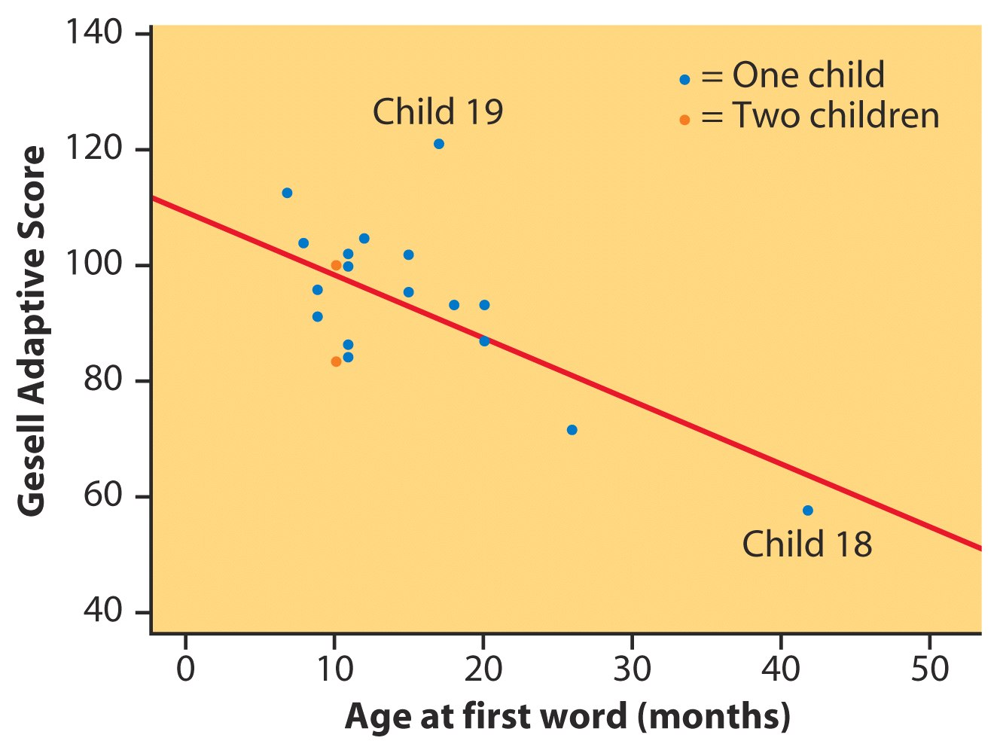
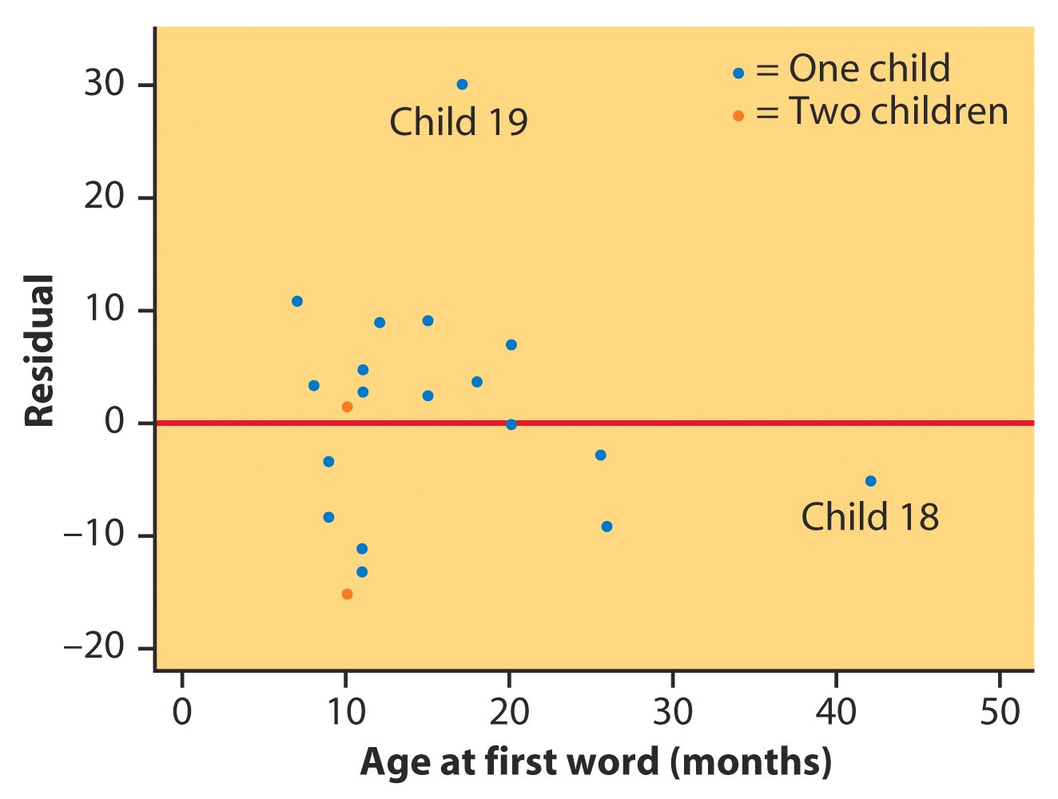
Residual Plots
A residual plot is a scatterplot of the regression residuals against the explanatory variable. Residual plots help us assess the fit of a regression line.
  Ideally there should be a “random” scatter around zero.
  Residual patterns suggest deviations from a linear relationship.
Gesell Adaptive Score and Age at First Word

Slide 33
Outliers and Influential Points 1
An outlier is an observation that lies outside the overall pattern of the other observations.
  Outliers in the y direction have large residuals.
  Outliers in the x direction are often influential for the least-squares regression line, meaning that the removal of such points would markedly change the equation of the line.

Slide 34
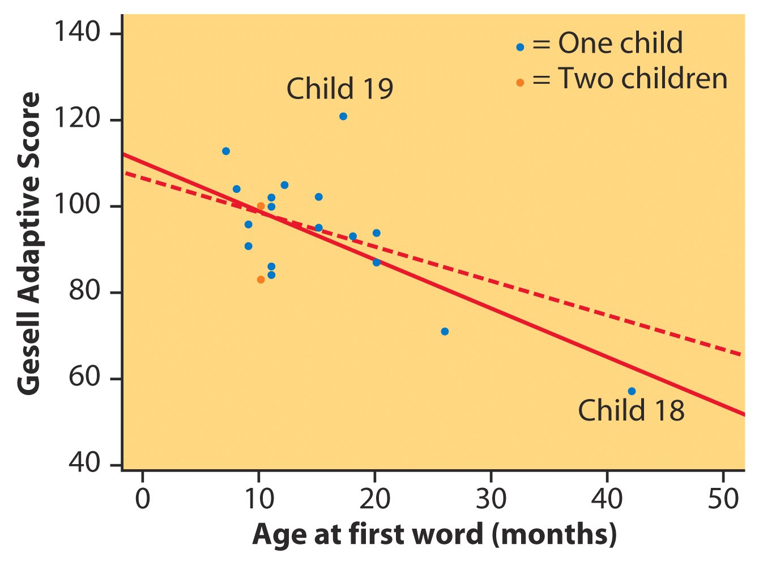
Outliers and Influential Points 2
Gesell Adaptive Score and Age at First Word
After removing child 18
r² = 11%
From all the data
r² = 41%

Slide 35
Lurking Variables
A lurking variable is a variable that is not among the explanatory or response variables and yet may influence the interpretation of relationships among those variables.
Winter Months
Gas expense seems to be negatively associated with electricity expense.
BUT season is a lurking variable.
SummerMonths

Slide 36
Cautions about Correlation and Regression
Both describe linear relationships.
Both are affected by outliers.
Always plot the data before interpreting.
Beware of extrapolation.
    Use caution in predicting y when x is outside the range of observed x’s.
Beware of lurking variables.
    These have an important effect on the relationship among the variables in a study but are not included in the study.
Correlation does not imply causation!

Slide 37
2.6 Data Analysis for
Two-Way Tables
The two-way table
Joint and marginal distributions
Conditional distributions
Simpson’s paradox

Slide 38
Categorical Variables
Categorical variables place individuals into one of several groups or categories.
The values of a categorical variable are labels for the different categories.
The distribution of a categorical variable lists the count or percent of individuals who fall into each category.
When a data set involves two categorical variables, we begin by examining the counts or percents in various categories for one of the variables.
A two-way table describes two categorical variables, organizing counts according to a row variable and a column variable. Each combination of values for these two variables is called a cell.

Slide 39
The Two-Way Table
Young Adults by Gender and Chance of Getting Rich by Age 30
 | Female | Male | Total
Almost no chance | 96 | 98 | 194
Some chance, but probably not | 426 | 286 | 712
A 50–50 chance | 696 | 720 | 1416
A good chance | 663 | 758 | 1421
Almost certain | 486 | 597 | 1083
Total | 2367 | 2459 | 4826
What are the variables described by this two-way table?
How many young adults were surveyed?

Slide 40
Marginal Distribution 1
The marginal distribution of one of the categorical variables in a two-way table of counts is the distribution of values of that variable among all individuals described by the table.
Note: Percentages are often more informative than counts, especially when one is comparing groups of different sizes.
To examine a marginal distribution:
Use the data in the table to calculate the marginal distribution
(in percent) of the row or column totals.
2. Make a graph to display the marginal distribution.

Slide 41
Marginal Distribution 2
Young Adults by Gender and Chance of Getting Rich
 | Female | Male | Total
Almost no chance | 96 | 98 | 194
Some chance, but probably not | 426 | 286 | 712
A 50–50 chance | 696 | 720 | 1416
A good chance | 663 | 758 | 1421
Almost certain | 486 | 597 | 1083
Total | 2367 | 2459 | 4826
Examine the marginal distribution of chance of getting rich.
Response | Percent
Almost no chance | 194/4826 = 4.0%
Some chance | 712/4826 = 14.8%
A 50–50 chance | 1416/4826 = 29.3%
A good chance | 1421/4826 = 29.4%
Almost certain | 1083/4826 = 22.4%

Slide 42
Conditional Distribution 1
Marginal distributions tell us nothing about the relationship between two variables. For that, we need to explore the conditional distributions of the variables.
A conditional distribution of a variable describes the values of that variable among individuals who have a specific value of another variable.
To examine or compare conditional distributions:
Select the row(s) or column(s) of interest.
Use the data in the table to calculate the conditional distribution (in percent) of the row(s) or column(s).
Make a graph to display the conditional distribution.
  Use a side-by-side bar graph or a segmented bar graph to compare distributions.

Slide 43
Conditional Distribution 2
Young adults by gender and chance of getting rich
 | Female | Male | Total
Almost no chance | 96 | 98 | 194
Some chance, but probably not | 426 | 286 | 712
A 50–50 chance | 696 | 720 | 1416
A good chance | 663 | 758 | 1421
Almost certain | 486 | 597 | 1083
Total | 2367 | 2459 | 4826
Calculate the conditional distribution of opinion among males.
Examine the relationship between gender and opinion.
Response | Male
Almost no chance | 98/2459 = 4.0%
Some chance | 286/2459 = 11.6%
A 50–50 chance | 720/2459 = 29.3%
A good chance | 758/2459 = 30.8%
Almost certain | 597/2459 = 24.3%
Female
96/2367 = 4.1%
426/2367 = 18.0%
696/2367 = 29.4%
663/2367 = 28.0%
486/2367 = 20.5%

Slide 44
Simpson’s Paradox 1
When studying the relationship between two variables, remember that there may exist a lurking variable that creates a reversal in the direction of the relationship when the lurking variable is ignored, as opposed to the direction of the relationship when the lurking variable is considered.
The lurking variable creates subgroups, and failure to take these subgroups into consideration can lead to misleading conclusions about the association between the two variables.
An association or comparison that holds for all of several groups can reverse direction when the data are combined to form a single group! This reversal is called Simpson’s paradox.

Slide 45
Simpson’s Paradox 2
Consider the acceptance rates for the following groups of men and women who applied to college.
Counts | Accepted | Not accepted | Total
Men | 198 | 162 | 360
Women | 88 | 112 | 200
Total | 286 | 274 | 560
Percents | Accepted | Not accepted
Men | 55% | 45%
Women | 44% | 56%
A higher percentage of men were accepted.
Is there evidence of discrimination?

Slide 46
Simpson’s Paradox 3
Consider the acceptance rates when they are broken down by type of school.
BUSINESS SCHOOL
Counts | Accepted | Not accepted | Total
Men | 18 | 102 | 120
Women | 24 | 96 | 120
Total | 42 | 198 | 240
Percents | Accepted | Not accepted
Men | 15% | 85%
Women | 20% | 80%
ART SCHOOL
Counts | Accepted | Not accepted | Total
Men | 180 | 60 | 240
Women | 64 | 16 | 80
Total | 244 | 76 | 320
Percents | Accepted | Not accepted
Men | 75% | 25%
Women | 80% | 20%

Slide 47
Simpson’s Paradox 4
Lurking variable: Applications were split between the Business School (240) and the Art School (320).
Within each school, a higher percentage of women were accepted than of men.
There is not any discrimination against women!
This is an example of Simpson’s paradox.
When the lurking variable (Type of School: Business or Art) is ignored, the data seem to suggest discrimination against women.
However, when the type of school is considered, the association is reversed and suggests discrimination against men.

Slide 48
2.7 The Question of Causation
Explaining association
Causation
Common response
Confounding
Establishing causation

Slide 49
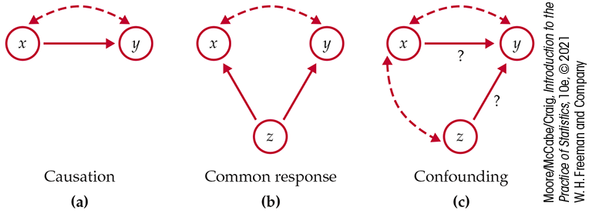
Explaining Association: Causation
Association, however strong, does NOT imply causation.
Some possible explanations for an observed association:
The dashed lines show an association.
The solid arrows show a cause-and-effect link.
x is an explanatory variable, y is a response variable, and z is a lurking variable.

Slide 50
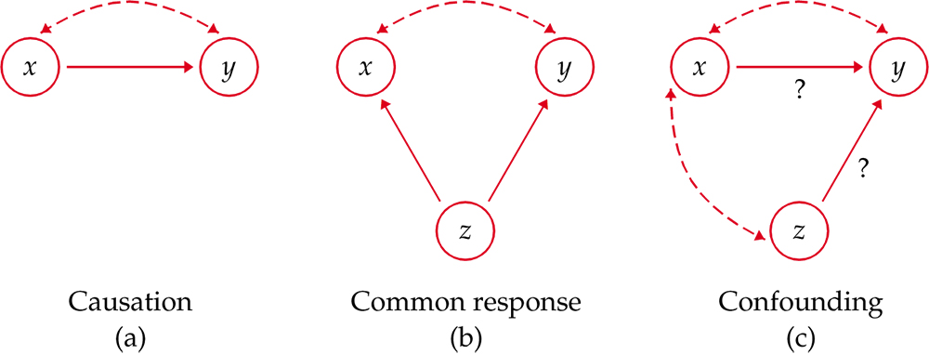
Explaining Association: Common Response
“Beware the lurking variable” is good advice when thinking about an association between two variables. The observed relationship between the variables can be explained by a lurking variable. Both x and y may change in response to changes in z.
Most students who have high SAT scores (x) in high school have high GPAs (y) in their first year of college.
This positive correlation can be explained as a common response to students’ ability and knowledge.
The observed association between x and y could be explained by a third lurking variable z. In this example, “ability and knowledge” is the lurking variable.
Both x and y change in response to changes in z. This creates an association, even though there is no direct causal link.

Slide 51
Explaining Association: Confounding
Two variables are confounded when their effects on a response variable cannot be distinguished from each other. The confounded variables may be either explanatory variables or lurking variables.
Example: Studies have found that religious people live longer than nonreligious people.
Religious people also take better care of themselves and are less likely to smoke or to be overweight.

Slide 52
Establishing Causation
It appears that lung cancer is associated with smoking.
How do we know that both of these variables are not being affected by an unobserved third (lurking) variable?
For instance, what if there is a genetic predisposition that causes people both to get lung cancer and to become addicted to smoking, but the smoking itself does not CAUSE lung cancer?
We can evaluate the association using the following criteria:
The association is strong.
The association is consistent.
Higher doses are associated with stronger responses.
The alleged cause precedes the effect.
The alleged cause is plausible.

Slide 53
Evidence of Causation
A properly conducted experiment may establish causation.
Other things to consider when we cannot do an experiment:
  The association is strong.
  The association is consistent.
    The connection happens in repeated trials.
    The connection happens under varying conditions.
  Higher doses are associated with stronger responses.
  The alleged cause precedes the effect in time.
  The alleged cause is plausible (reasonable explanation).

Slide 54
Chapter 2
Looking at Data — Relationships (Review)
2.1 Relationships
2.2 Scatterplots
2.3 Correlation
2.4 Least-Squares Regression
2.5 Cautions about Correlation and Regression
2.6 Data Analysis for Two-Way Tables
2.7 The Question of Causation

